Slide 1

CSS PREPROCESSORS
Gjorge Dimitrov
Trainer
Ilija Mitev
Assistant

Slide 2

01
BEM
methodology

Slide 3
Block Element Modifier
The Block, Element, Modifier methodology (commonly referred to as BEM) is a popular naming convention for classes in HTML and CSS. Developed by the team at Yandex, its goal is to help developers better understand the relationship between the HTML and CSS in a given project.

Slide 4
Why should we consider BEM?
If we want to make a new style of a component, we can easily see which modifiers and children already exist. We might even realize we don’t need to write any CSS in the first place because there is a pre-existing modifier that does what we need.
If we are reading the markup instead of CSS, we should be able to quickly get an idea of which element depends on another (in the previous example we can see that .btn__price depends on .btn, even if we don’t know what that does just yet.)
Designers and developers can consistently name components for easier communication between team members. In other words, BEM gives everyone on a project a declarative syntax that they can share so that they’re on the same page.

Slide 5
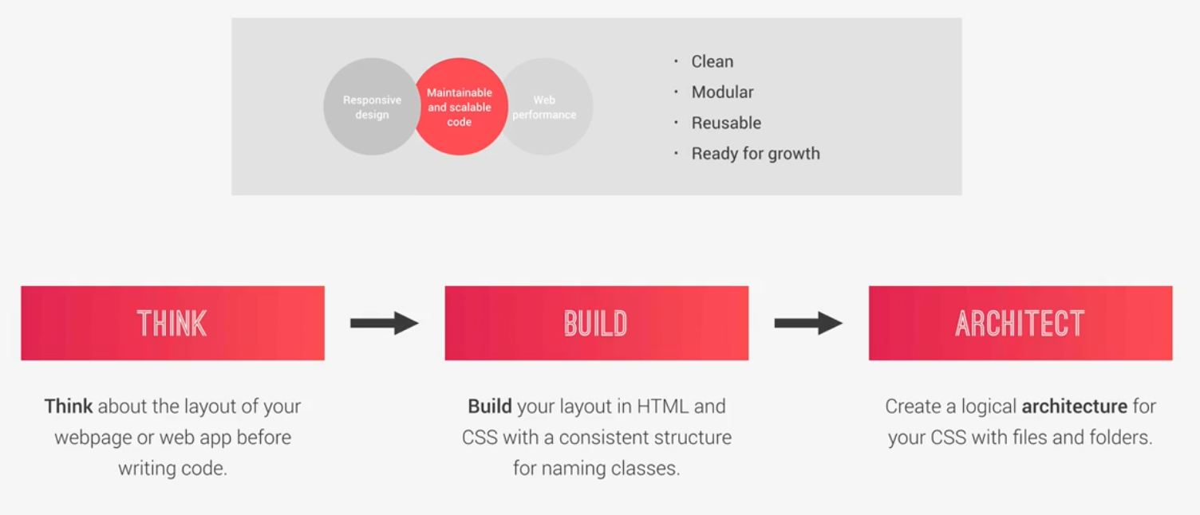
The think - build - architect mindset

Slide 6
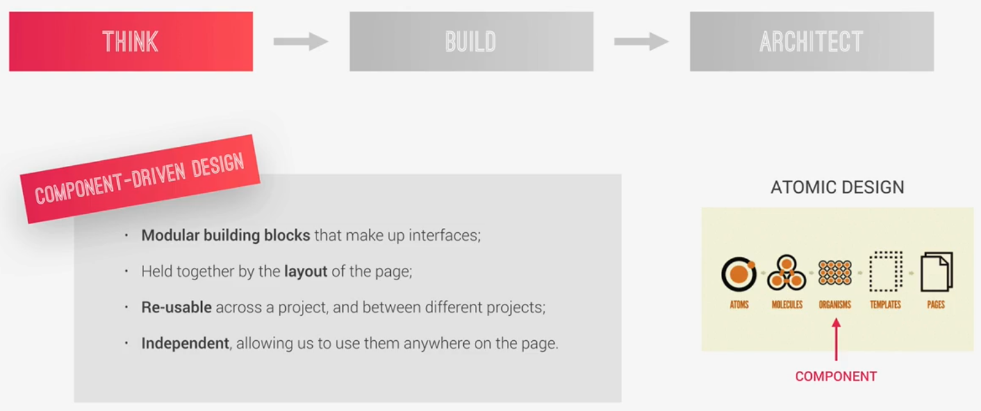
Thinking about the layout

Slide 7
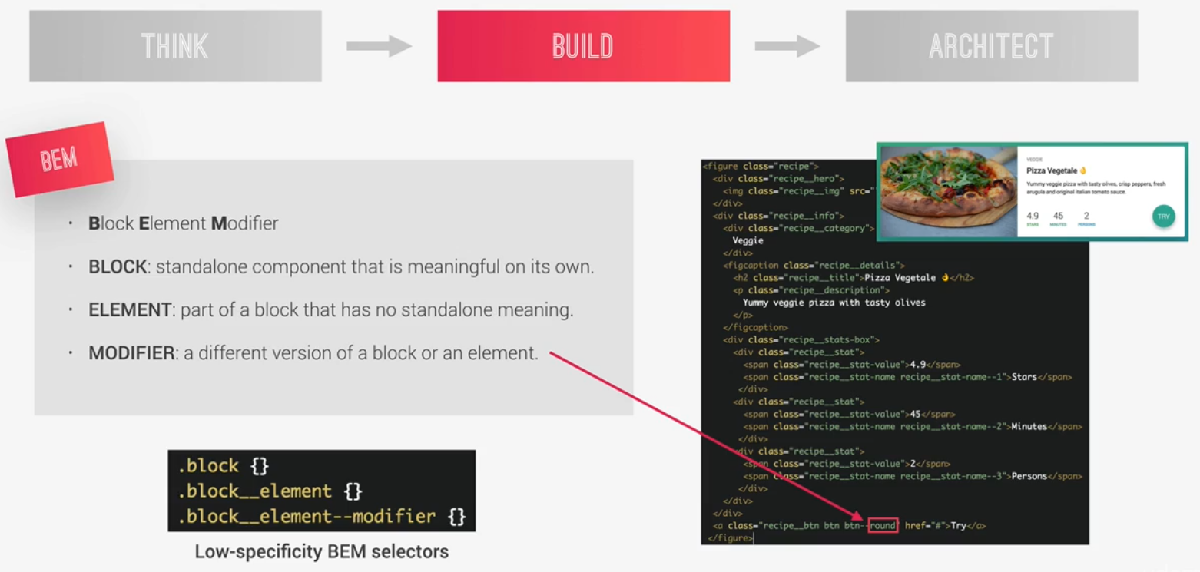
Building with meaningful class names

Slide 8
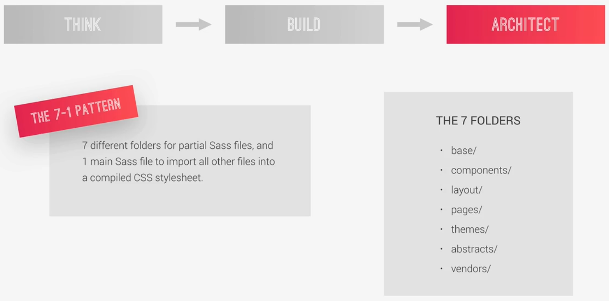
Architect with files and folders

Slide 9
CSS Preprocessors
A CSS preprocessor is a program that lets you generate CSS from the preprocessor's own unique syntax. There are many CSS preprocessors to choose from, however most CSS preprocessors will add some features that don't exist in pure CSS, such as mixin, nesting selector, inheritance selector, and so on. These features make the CSS structure more readable and easier to maintain.

Slide 10

SASS
Sass is a CSS preprocessor, an extension of CSS that adds power and elegance to the basic language.

Slide 11
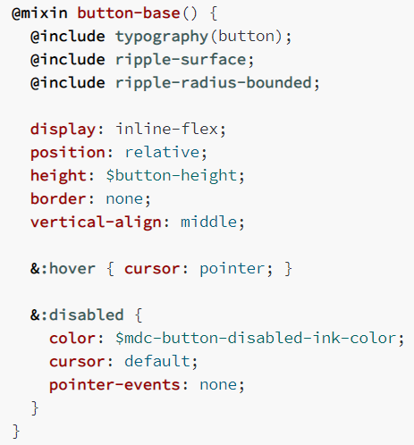
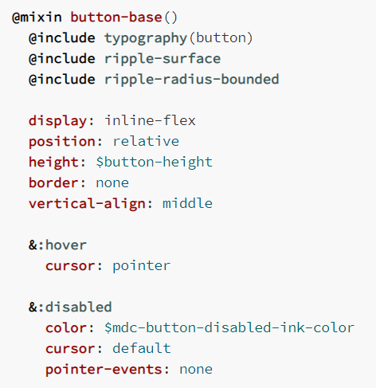
Syntax
SCSS SASS

Slide 12
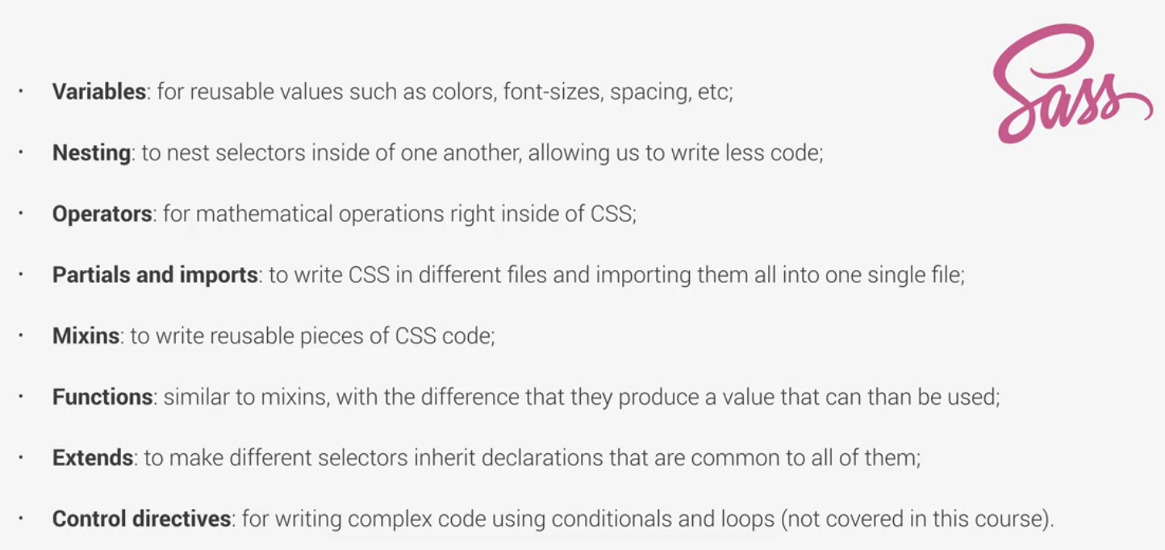
Main Sass features

Slide 13

The FE Team
Gjorge Dimitrov
Ilija
Mitev
Front End Developer
Front End Developer

Slide 14

THANKS
Does anyone have any questions?
dimitrov.gjorge@protonmailc.com
ilija_mitev_mk@yahoo.com

